Slide 1
Probability
Permutation, Combination

Slide 2


Slide 3
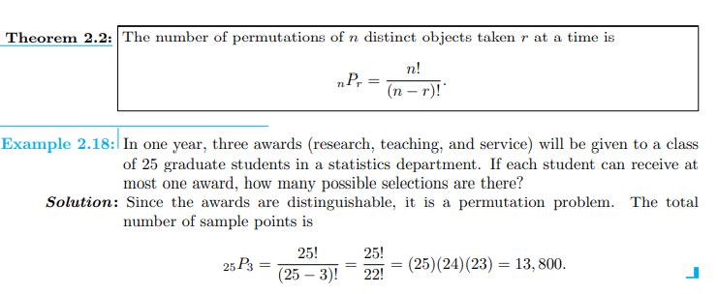

Slide 4
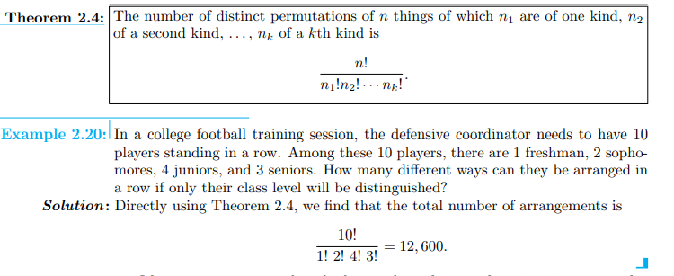

Slide 5
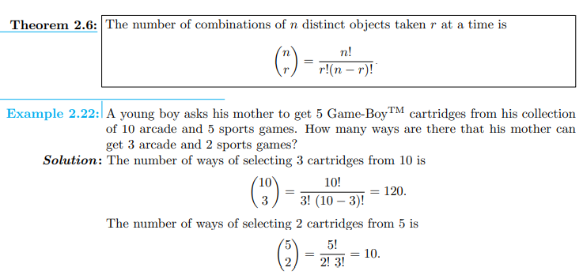

Slide 6
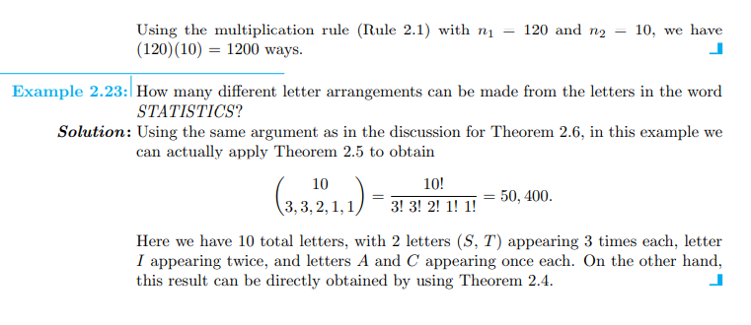

Slide 7
Exwecise
Q# 2.21-2.30

